Slide 1
Digital Portfolio
STUDENT NAME: R.SIVAKUMAR
REGISTER NO AND NMID: asunm287222403649
DEPARTMENT: BSC COMPUTER SCIENCE
COLLEGE: COLLEGE/ UNIVERSITY:MADRAS UNIVERSITY

Slide 2
PROJECT TITLE
Student Portfolio

Slide 3


AGENDA
Probem Statement
Project Overview
End Users
Tools and Technologies
Portfolio design and Layout
Features and Functionality
Results and Screenshots
Conclusion
Github Link
3/21/2024 Annual Review

Slide 4

PROBLEMSTATEMENT
In today’s generation many students struggle to present their projects,pratical,certifications skills in a
Clear and professional manner.Traditional resumes focus mainly on academics and falls to highlight
Creativity.Innovations,andreal-world experience.This creates a gap between students abilites and the
Opportunites they deserves.A well-structured digital portfolio solves this problem by showcasing
Achievement,technical,skills,and personal growth in an engaging format.

Slide 5

PROJECTOVERVIEW
Brief summary of my project.
My portfolio contain(aboutme,projects,skills,contact)
Main idea to show my personal achievement,skills,and projects.
I have proceed all of my informations in this project.

Slide 6

WHO ARE THE END USERS?
Student(academic,projects,resumes,bio-data).
Job seekers(to share with recruiters).
Freelancers(to show clients).
Researches(to showcase publications and research).

Slide 7

TOOLS AND TECHNIQUES
HTML->Structure(pages,section).
CSS->Styling(colors,layouts,responsiveness).
JavaScript->Interactive(navigation menu,animations,forms,validation).
Mention code editor(VS CODE)or CODEPEN and hosting(GitHug Pages).

Slide 8
PORTFOLIO DESIGN AND LAYOUT
Section included.
Home/About Me.
Projects.
Skills.
Contact.
Responsive Layout(Mobile+desktop view).
8

Slide 9
FEATURES AND FUNCTIONALITY
Navigation bar with smooth scrolling.
Project showcase with images/details.
Interactive elements(hover effects,animations).
Contact form(with validation).

Slide 10
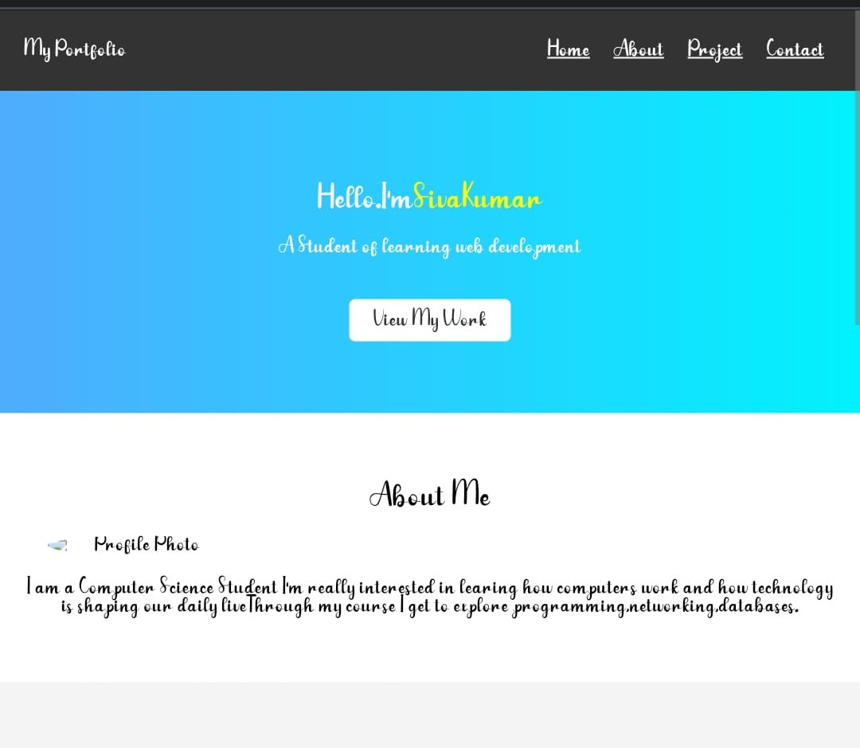
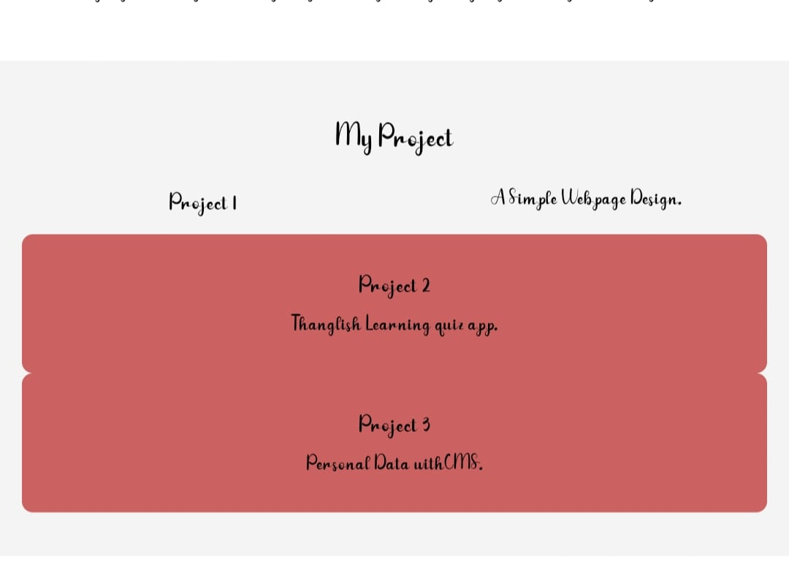

RESULTS AND SCREENSHOTS
3/21/2024 Annual Review
10

Slide 11
CONCLUSION
Highlights of my project.
Final Summary.
Benefits to society.
Future Enchancement->scope of adding new features and improvement.
11

